Slide 1
Fundamentals of Python:
From First Programs Through Data Structures
Chapter 17
Recursion

Slide 2
Objectives
After completing this chapter, you will be able to:
Explain how a recursive, divide-and-conquer strategy can be used to develop n log n sort algorithms
Develop recursive algorithms for processing recursive data structures
Use a recursive strategy to implement a backtracking algorithm
Fundamentals of Python: From First Programs Through Data Structures

Slide 3
Objectives (continued)
Describe how recursion can be used in software that recognizes or parses sentences in a language
Recognize the performance trade-offs between recursive algorithms and iterative algorithms
Fundamentals of Python: From First Programs Through Data Structures

Slide 4
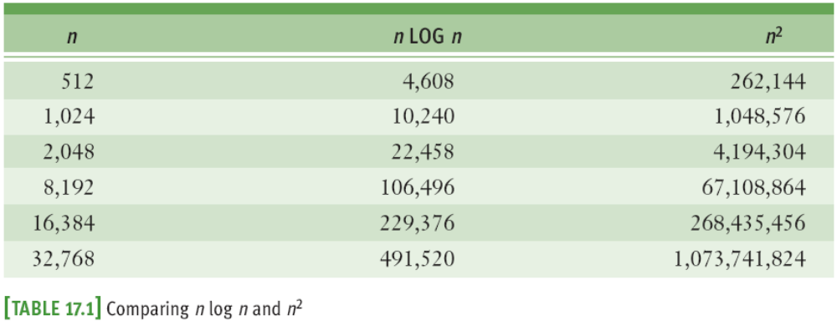
n log n Sorting
Sort algorithms you studied in Chapter 11 have O(n²) running times
Better sorting algorithms are O(n log n)
  Use a divide-and-conquer strategy
Fundamentals of Python: From First Programs Through Data Structures

Slide 5
Overview of Quicksort
Begin by selecting item at list’s midpoint (pivot)
Partition items in the list so that all items less than the pivot end up at the left of the pivot, and the rest end up to its right
Divide and conquer
  Reapply process recursively to sublists formed by splitting list at pivot
Process terminates each time it encounters a sublist with fewer than two items
Fundamentals of Python: From First Programs Through Data Structures

Slide 6
Partitioning
One way of partitioning the items in a sublist:
  Interchange the pivot with the last item in the sublist
  Establish a boundary between the items known to be less than the pivot and the rest of the items
  Starting with first item in sublist, scan across sublist
    When an item < pivot is encountered, swap it with first item after the boundary and advance the boundary
  Finish by swapping the pivot with the first item after the boundary
Fundamentals of Python: From First Programs Through Data Structures

Slide 7
Complexity Analysis of Quicksort
Best-case performance: O(n log n)
  When each time, the dividing line between the new sublists turns out to be as close to the center of the current sublist as possible
Worst-case performance: O(n²) ← list is sorted
If implemented as a recursive algorithm, must also consider memory usage for the call stack
  O(log n) in the best case and O(n) in the worst case
When choosing pivot, selecting a random position helps approximate O(n log n) performance in average case
Fundamentals of Python: From First Programs Through Data Structures

Slide 8
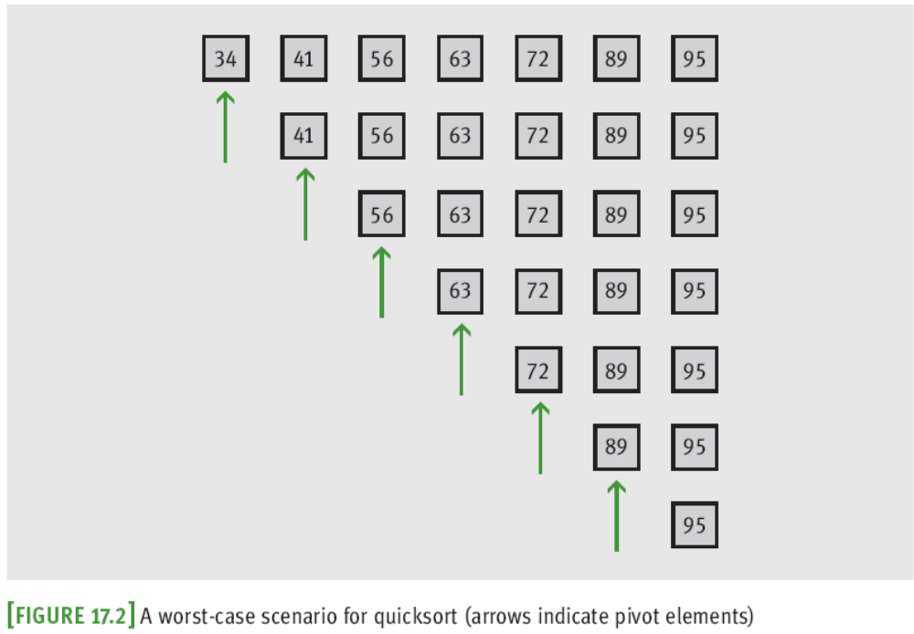
Complexity Analysis of Quicksort (continued)
Fundamentals of Python: From First Programs Through Data Structures

Slide 9
Implementation of Quicksort
The quicksort algorithm is most easily coded using a recursive approach
The following script defines:
  A top-level quicksort function for the client
  A recursive quicksortHelper function to hide the extra arguments for the end points of a sublist
  A partition function
Fundamentals of Python: From First Programs Through Data Structures

Slide 10
Merge Sort
Employs a recursive, divide-and-conquer strategy to break the O(n²) barrier:
  Compute the middle position of a list and recursively sort its left and right sublists (divide and conquer)
  Merge sorted sublists back into a single sorted list
  Stop when sublists can no longer be subdivided
Three functions collaborate in this strategy:
  mergeSort
  mergeSortHelper
  merge
Fundamentals of Python: From First Programs Through Data Structures

Slide 11
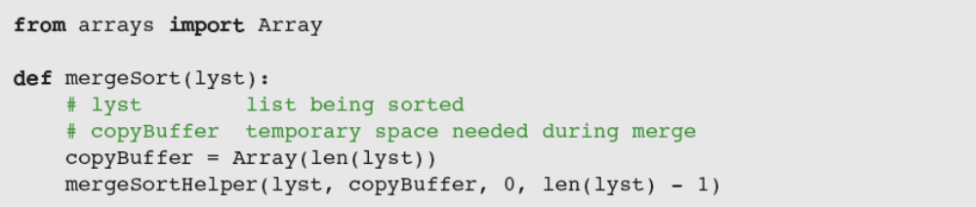
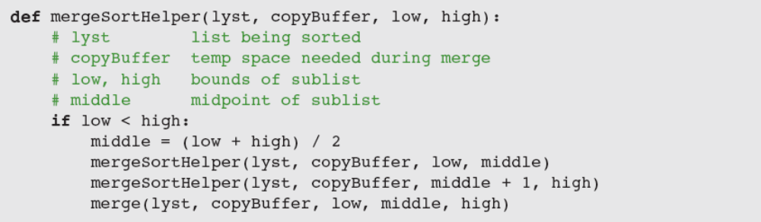
Merge Sort (continued)
Fundamentals of Python: From First Programs Through Data Structures

Slide 12
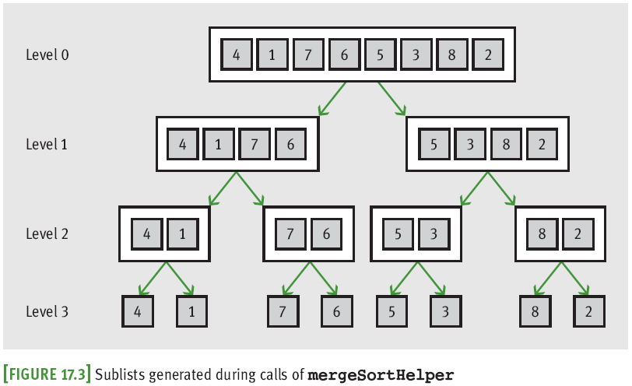
Merge Sort (continued)
Fundamentals of Python: From First Programs Through Data Structures

Slide 13
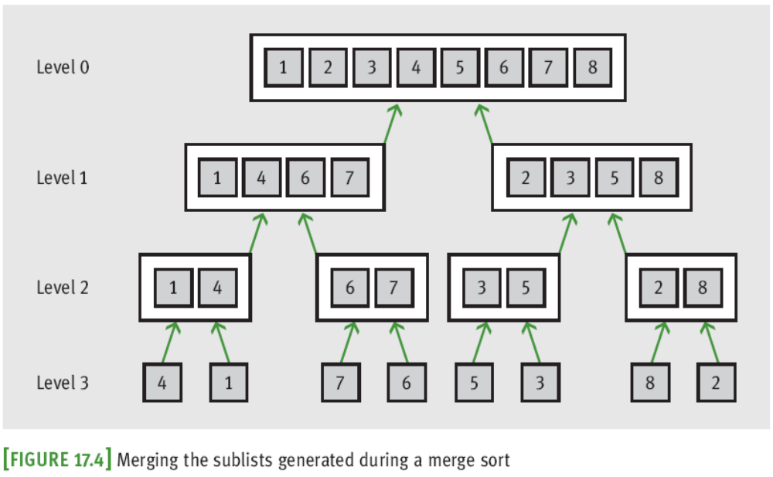
Merge Sort (continued)
Fundamentals of Python: From First Programs Through Data Structures

Slide 14
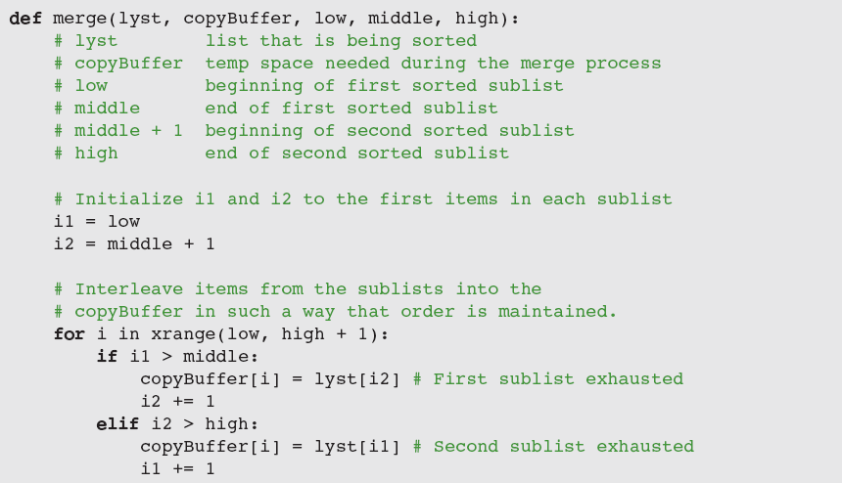
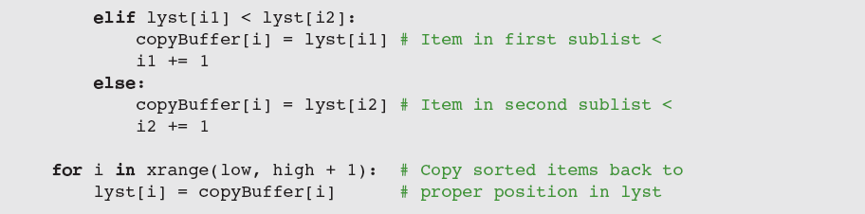
Merge Sort (continued)
Fundamentals of Python: From First Programs Through Data Structures

Slide 15
Complexity Analysis for Merge Sort
Maximum running time is O(n log n) in all cases:
  Running time of merge is dominated by two for statements; each loops (high - low + 1) times
    Running time is O(high - low)
    All the merges at a single level take O(n) time
  mergeSortHelper splits sublists as evenly as possible at each level; number of levels is O(log n)
Space requirements depend on the list’s size:
  O(log n) space is required on the call stack to support recursive calls
  O(n) space is used by the copy buffer
Fundamentals of Python: From First Programs Through Data Structures

Slide 16
Recursive List Processing
Lisp: General-purpose, symbolic information-processing language
  Developed by computer scientist John McCarthy
  Stands for list processing
  Basic data structure is the list
A Lisp list is a recursive data structure
  Lisp programs often consist of a set of recursive functions for processing lists
We explore recursive list processing by developing a variant of Lisp lists
Fundamentals of Python: From First Programs Through Data Structures

Slide 17
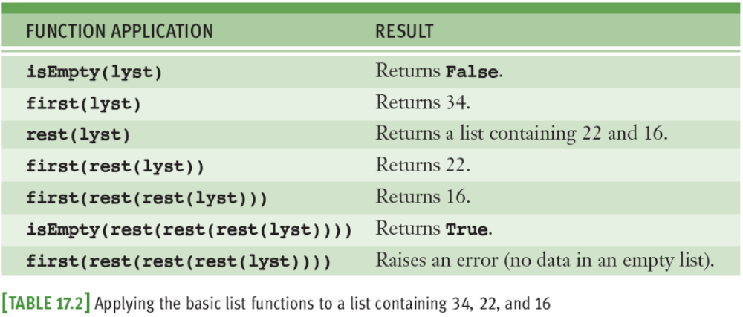
Basic Operations on a Lisp-Like List
A Lisp-like list is either empty or consists of two parts: a data item followed by another list
  Recursive definition
Fundamentals of Python: From First Programs Through Data Structures

Slide 18
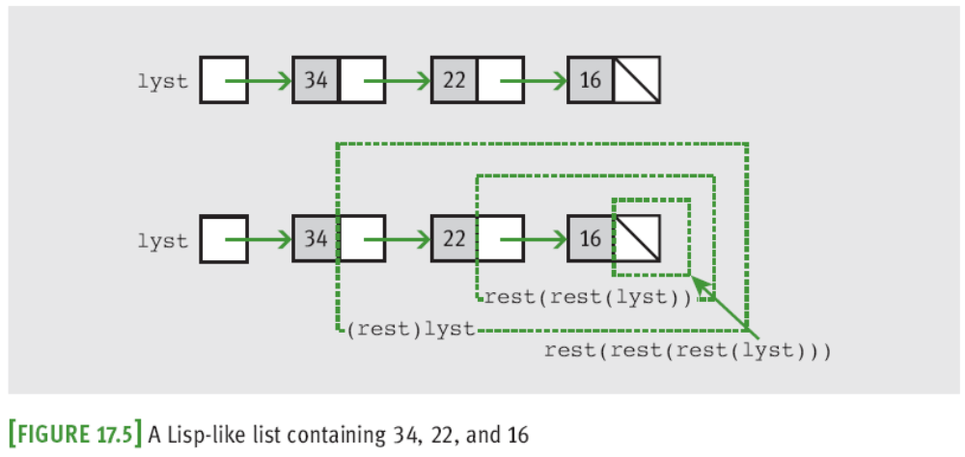
Basic Operations on a Lisp-Like List (continued)
Base case of the recursive definition is the empty list; recursive case is a structure that contains a list
Fundamentals of Python: From First Programs Through Data Structures

Slide 19
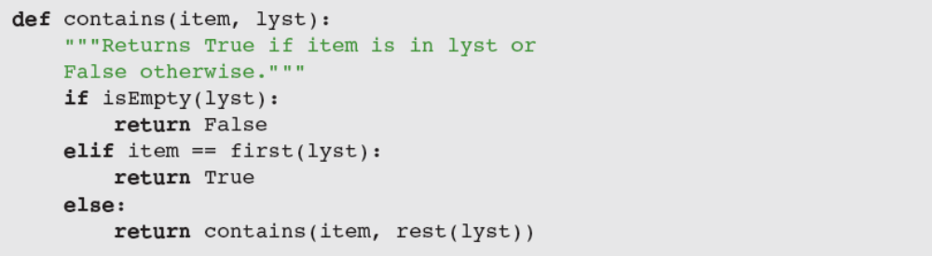
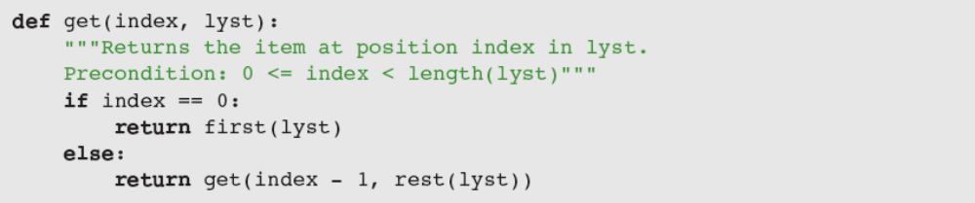
Recursive Traversals of a Lisp-Like List
We can define recursive functions to traverse lists
Fundamentals of Python: From First Programs Through Data Structures

Slide 20
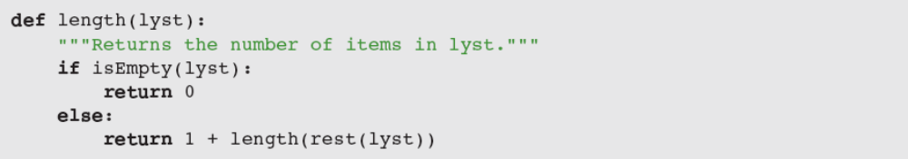
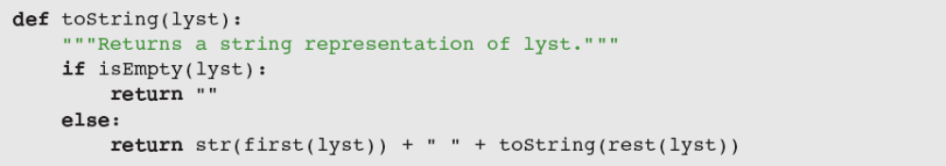
Recursive Traversals of a Lisp-Like List (continued)
A wide range of recursive list-processing functions can be defined simply in terms of the basic list access functions isEmpty, first, and rest
Fundamentals of Python: From First Programs Through Data Structures

Slide 21
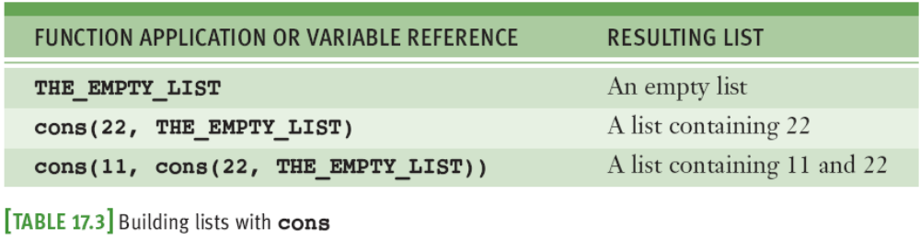
Building a Lisp-Like List
A Lisp-like list has a single basic constructor function named cons
  first(cons(A, B)) == A
  rest(cons(A, B)) == B
Lists with more than one data item are built by successive applications of cons
Fundamentals of Python: From First Programs Through Data Structures

Slide 22
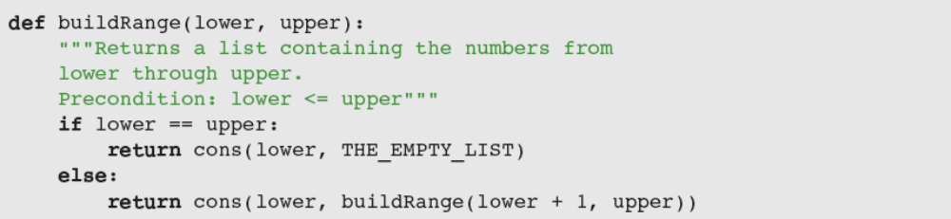
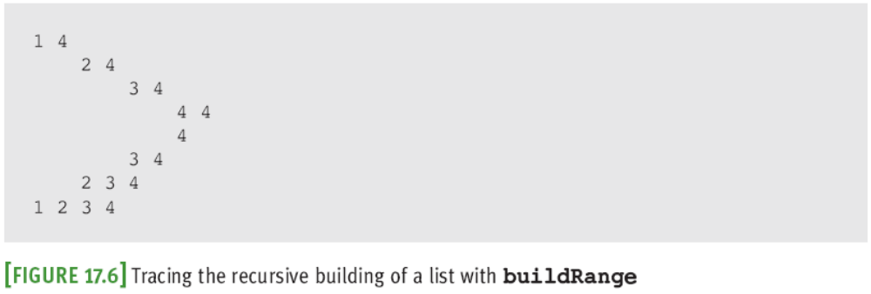
Building a Lisp-Like List (continued)
Fundamentals of Python: From First Programs Through Data Structures

Slide 23
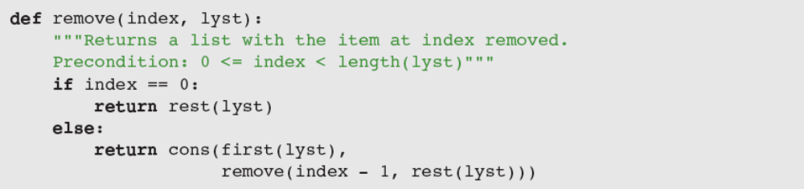
Building a Lisp-Like List (continued)
The recursive pattern in the function just shown is found in many other list-processing functions
  For example, to remove the item at the ith position
Fundamentals of Python: From First Programs Through Data Structures

Slide 24
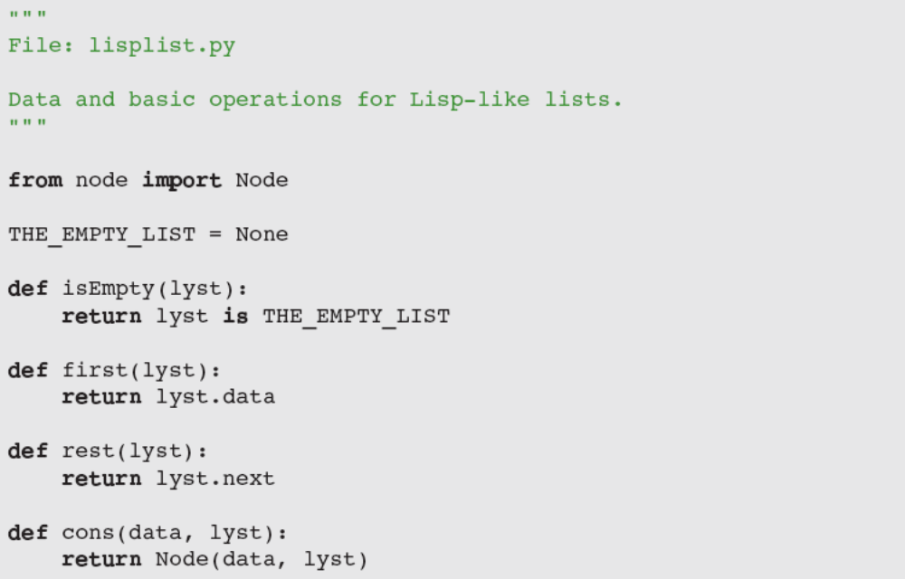
The Internal Structure of a Lisp-Like List
The user of this ADT doesn’t have to know anything about nodes, links, or pointers
Fundamentals of Python: From First Programs Through Data Structures

Slide 25
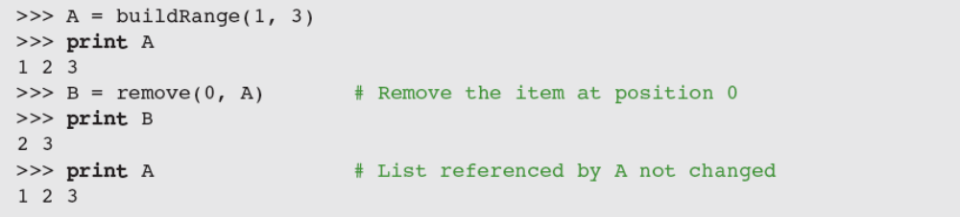
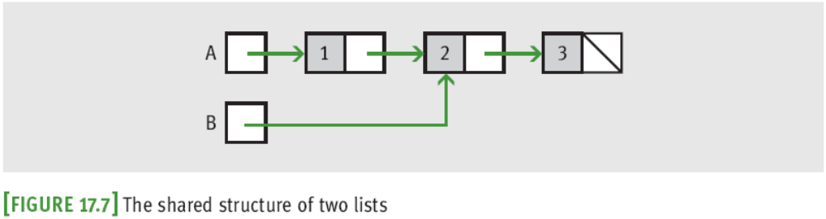
Lists and Functional Programming
Lisp-like lists have no mutator operations
Fundamentals of Python: From First Programs Through Data Structures

Slide 26
Lists and Functional Programming (continued)
When no mutations are possible, sharing structure is a good idea because it can save on memory
Lisp-like lists without mutators fit nicely into a style of software development called functional programming
  A program written in this style consists of a set of cooperating functions that transform data values into other data values
Run-time cost of prohibiting mutations can be expensive
Fundamentals of Python: From First Programs Through Data Structures

Slide 27
Recursion and Backtracking
Approaches to backtracking:
  Using stacks and using recursion
A backtracking algorithm begins in a predefined starting state and moves from state to state in search of a desired ending state
  When there is a choice between several alternative states, the algorithm picks one and continues
  If it reaches a state representing an undesirable outcome, it backs up to the last point at which there was an unexplored alternative and tries it
  Either exhaustively searches all states or reaches desired ending state
Fundamentals of Python: From First Programs Through Data Structures

Slide 28
A General Recursive Strategy
To apply recursion to backtracking, call a recursive function each time an alternative state is considered
  Recursive function tests the current state
    If it is an ending state, success is reported all the way back up the chain of recursive calls
    Otherwise, two possibilities:
      Recursive function calls itself on an untried adjacent state
      All states have been tried and recursive function reports failure to calling function
Activation records serve as memory of the system
Fundamentals of Python: From First Programs Through Data Structures

Slide 29
A General Recursive Strategy (continued)
SUCCESS = True
FAILURE = False
...
...
def testState(state)
  if state == ending state
  return SUCCESS
  else
    mark state as visited
    for all adjacent unvisited states
    if testState(adjacentState) == SUCCESS
  return SUCCESS
  return FAILURE
  outcome = testState(starting state)
Fundamentals of Python: From First Programs Through Data Structures

Slide 30
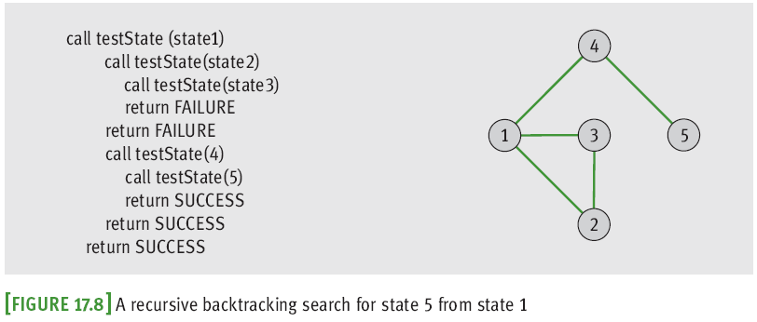
A General Recursive Strategy (continued)
In a specific situation, the problem details can lead to minor variations
  However, the general approach remains valid
Fundamentals of Python: From First Programs Through Data Structures

Slide 31
The Maze Problem Revisited
We represent a maze as a grid of characters
With two exceptions, each character at a position (row, column) in this grid is initially either a space, indicating a path, or a star (*), indicating a wall
  Exceptions: Letters P (parking lot) and T (a mountaintop)
The algorithm leaves a period (a dot) in each cell that it visits so that cell will not be visited again
  We can discriminate between the solution path and the cells visited but not on the path by using two marking characters: the period and an X
Fundamentals of Python: From First Programs Through Data Structures

Slide 32
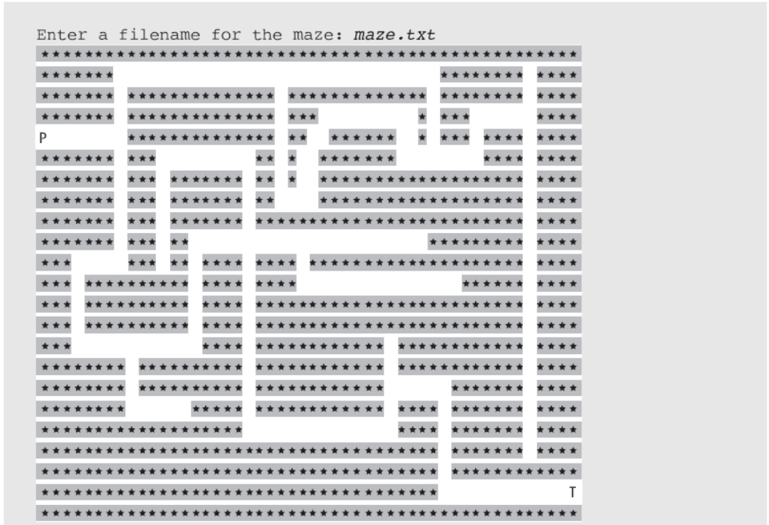
The Maze Problem Revisited (continued)
Fundamentals of Python: From First Programs Through Data Structures

Slide 33
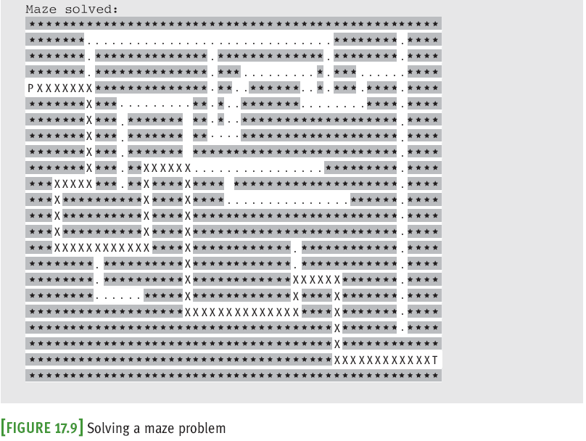
The Maze Problem Revisited (continued)
Fundamentals of Python: From First Programs Through Data Structures

Slide 34
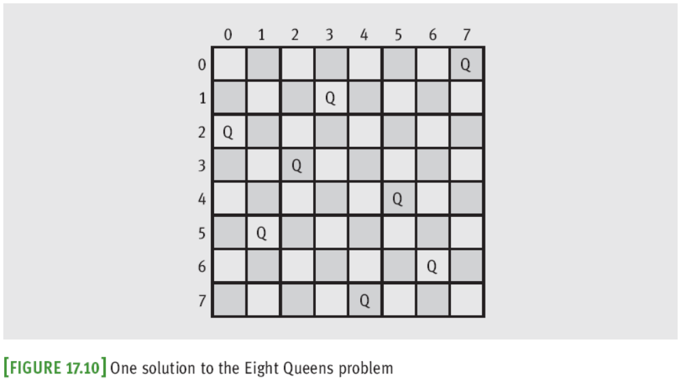
The Eight Queens Problem
Fundamentals of Python: From First Programs Through Data Structures

Slide 35
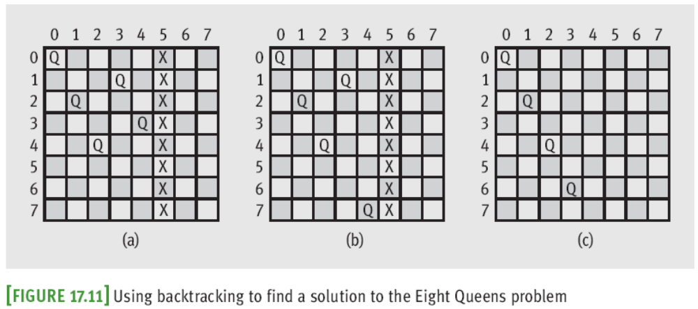
The Eight Queens Problem (continued)
Backtracking is the best approach that anyone has found to solving this problem
Fundamentals of Python: From First Programs Through Data Structures

Slide 36
The Eight Queens Problem (continued)
function canPlaceQueen(col, board)
  for each row in the board
    if board[row][col] is not under attack
      if col is the rightmost one
        place a queen at board[row][col]
        return True
      else:
        place a queen at board[row][col]
        if canPlaceQueen(col + 1, board)
        return True
        else
        remove the queen at board[row][col] (backtrack to previous column)
  return False
Fundamentals of Python: From First Programs Through Data Structures

Slide 37
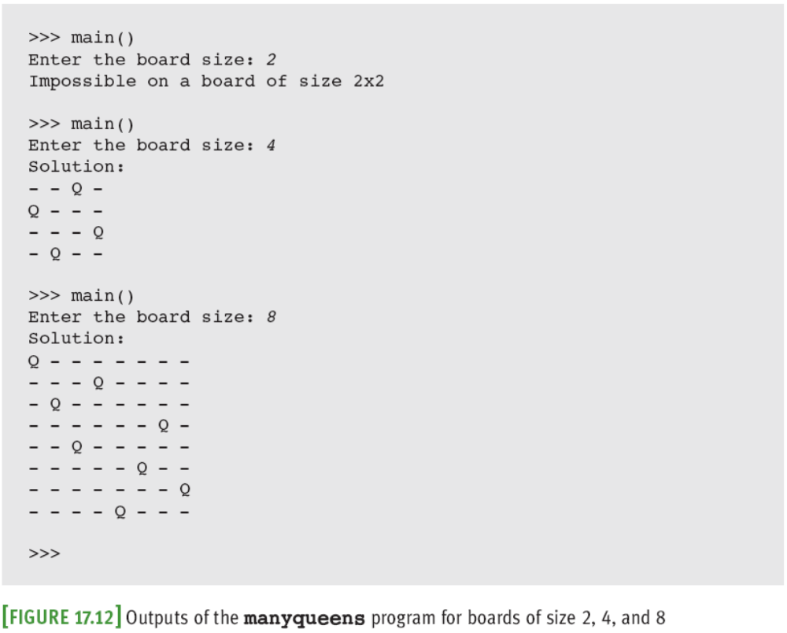
The Eight Queens Problem (continued)
Fundamentals of Python: From First Programs Through Data Structures

Slide 38
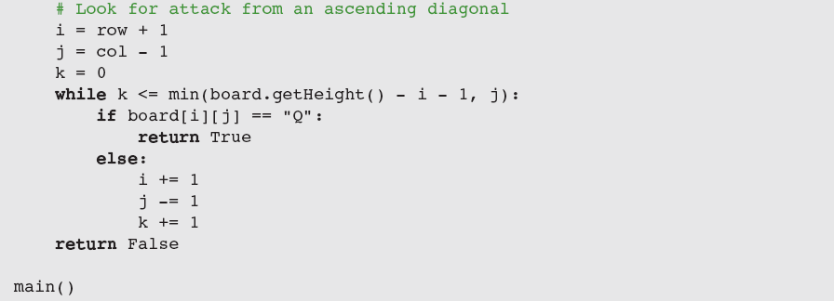
The Eight Queens Problem (continued)
Fundamentals of Python: From First Programs Through Data Structures

Slide 39
Recursive Descent and Programming Languages
Recursive algorithms are used in processing languages
  Whether they are programming languages such as Python or natural languages such as English
We give a brief overview of grammars, parsing, and a recursive descent-parsing strategy, followed in the next section by a related case study
Fundamentals of Python: From First Programs Through Data Structures

Slide 40
Introduction to Grammars
Most programming languages have a precise and complete definition called a grammar
A grammar consists of several parts:
  A vocabulary (dictionary or lexicon) consisting of words and symbols allowed in the language
  A set of syntax rules that specify how symbols in the language are combined to form sentences
  A set of semantic rules that specify how sentences in the language should be interpreted
Fundamentals of Python: From First Programs Through Data Structures

Slide 41
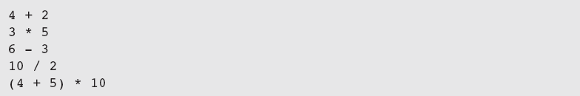
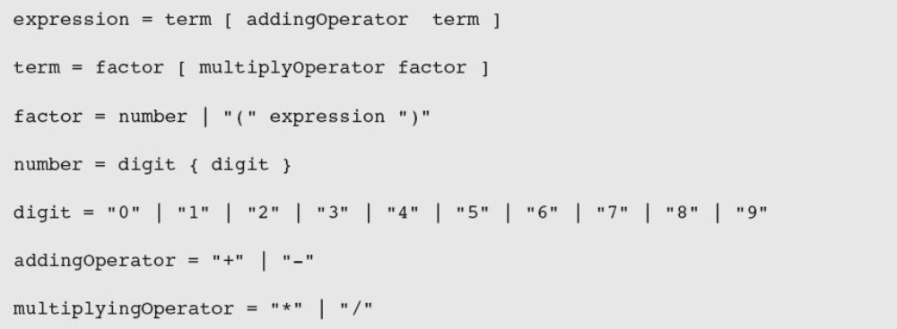
Introduction to Grammars (continued)
There are notations for expressing grammars
Fundamentals of Python: From First Programs Through Data Structures

Slide 42
Introduction to Grammars (continued)
This type of grammar is called an Extended Backus-Naur Form (EBNF) grammar
  Terminal symbols are in the vocabulary of the language and literally appear in programs in the language (e.g., + and *)
  Nonterminal symbols name phrases in the language (e.g., expression or factor in preceding examples)
    A phrase usually consists of one or more terminal symbols and/or the names of other phrases
  Metasymbols organize the rules in the grammar
Fundamentals of Python: From First Programs Through Data Structures

Slide 43
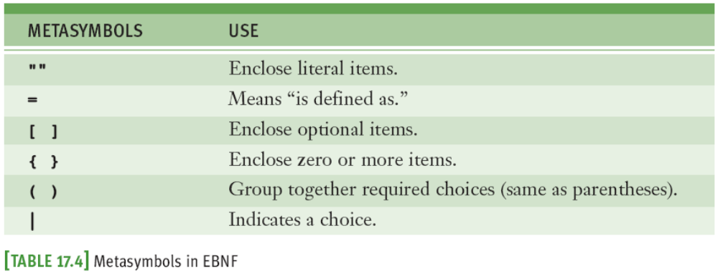
Introduction to Grammars (continued)
Fundamentals of Python: From First Programs Through Data Structures

Slide 44
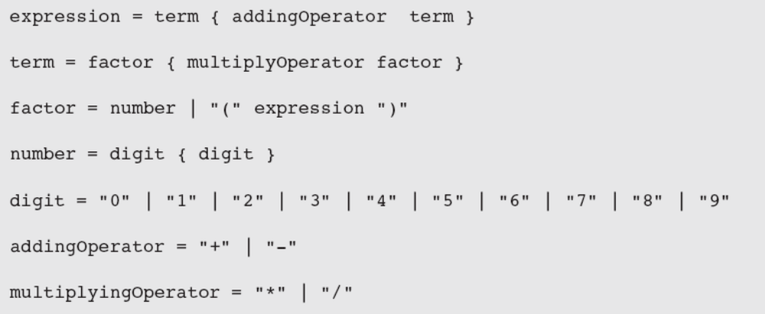
Introduction to Grammars (continued)
Earlier grammar doesn’t allow expressions such as 45 * 22 + 14 / 2, forcing programmers to use ( ) if they want to form an equivalent expression
  Solution:
Start symbol
Fundamentals of Python: From First Programs Through Data Structures

Slide 45
Recognizing, Parsing, and Interpreting Sentences in a Language
Recognizer: Analyzes a string to determine if it is a sentence in a given language
  Inputs: the grammar and a string
  Outputs: “Yes” or “No” and syntax error messages
Parser: Returns information about syntactic and semantic structure of sentence
  Info. used in further processing and might be contained in a parse tree or other representation
Interpreter: Carries out the actions specified by a sentence
Fundamentals of Python: From First Programs Through Data Structures

Slide 46
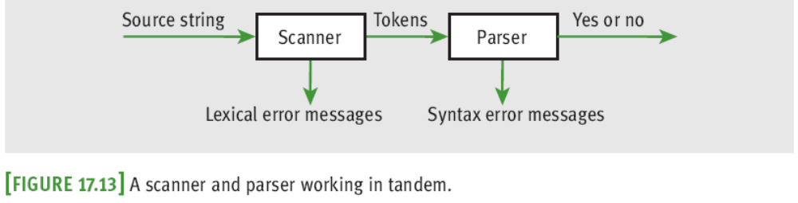
Lexical Analysis and the Scanner
It is convenient to assign task of recognizing symbols in a string to a scanner
  Performs lexical analysis, in which individual words are picked out of a stream of characters
  Output: tokens which become the input to the syntax analyzer
Fundamentals of Python: From First Programs Through Data Structures

Slide 47
Parsing Strategies
One of the simplest parsing strategies is called recursive descent parsing
  Defines a function for each rule in the grammar
  Each function processes the phrase or portion of the input sentence covered by its rule
  The top-level function corresponds to the rule that has the start symbol on its left side
  When this function is called, it calls the functions corresponding to the nonterminal symbols on the right side of its rule
Fundamentals of Python: From First Programs Through Data Structures

Slide 48
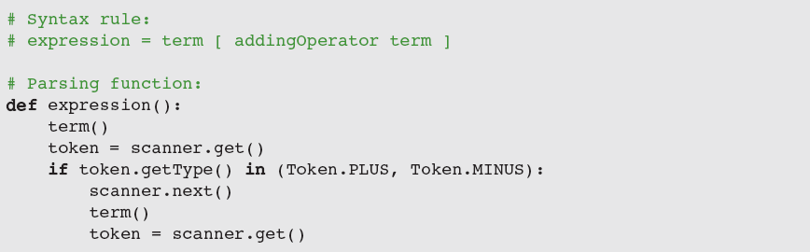
Parsing Strategies (continued)
  Nonterminal symbols are function names in parser
    Body processes phrases on right side of rule
  To process a nonterminal symbol, invoke function
  To process an optional item, use an if statement
  To observe current token, call get on scanner object
  To scan to next token, call next on scanner object
Fundamentals of Python: From First Programs Through Data Structures

Slide 49
Case Study: A Recursive Descent Parser
Request:
  Write a program that parses arithmetic expressions
Analysis:
  User interface prompts user for an arithmetic expression
  When user enters expression, program parses it and displays:
    “No errors” if expression is syntactically correct
    A message containing the kind of error and the input string up to the point of error, if a syntax error occurs
Fundamentals of Python: From First Programs Through Data Structures

Slide 50
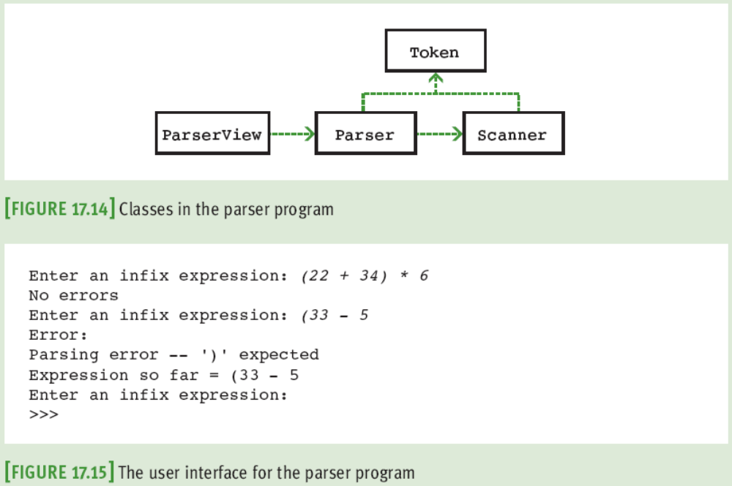
Case Study: A Recursive Descent Parser (continued)
Fundamentals of Python: From First Programs Through Data Structures

Slide 51
Case Study: A Recursive Descent Parser (continued)
Classes:
  We developed the Scanner and Token classes for evaluating expressions in Chapter 14
  To slightly modified versions of these, we add the classes Parser and ParserView
Implementation (Coding):
  The class Parser implements the recursive descent strategy discussed earlier
Fundamentals of Python: From First Programs Through Data Structures

Slide 52
The Costs and Benefits of Recursion
Recursive algorithms can always be rewritten to remove recursion
When developing an algorithm, you should balance several occasionally conflicting considerations:
  Efficiency, simplicity, and maintainability
Recursive functions usually are not as efficient as their nonrecursive counterparts
  However, their elegance and simplicity sometimes make them the preferred choice
Fundamentals of Python: From First Programs Through Data Structures

Slide 53
No, Maybe, and Yes
Some algorithms should never be done recursively
  Examples: summing numbers in a list; Fibonacci
Some algorithms can be implemented either way
  Example: binary search
    Both strategies are straightforward and clear
    Both have a maximum running time of O(log n)
    Overhead of function calls is unimportant considering that searching a list takes no more than 20 calls
Some algorithms are implemented best using recursion
  Example: quicksort
Fundamentals of Python: From First Programs Through Data Structures

Slide 54
Getting Rid of Recursion
Every recursive algorithm can be emulated as an iterative algorithm operating on a stack
  However, the general manner of making this conversion produces results that are too awkward
Tip: Approach each conversion on an individual basis
Frequently, recursion can be replaced by iteration
  Sometimes a stack is also needed
Fundamentals of Python: From First Programs Through Data Structures

Slide 55
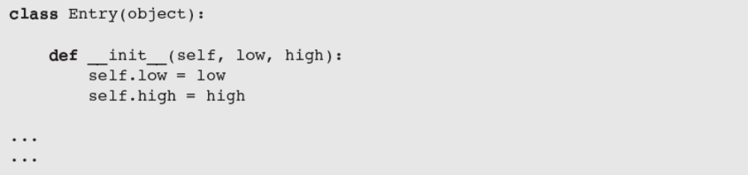
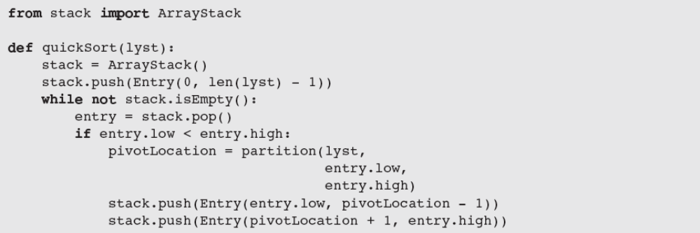
Getting Rid of Recursion (continued)
Fundamentals of Python: From First Programs Through Data Structures

Slide 56
Tail Recursion
Some recursive algorithms can be run without overhead associated with recursion
  Algorithms must be tail-recursive (i.e., no work is done in algorithm after recursive call)
Compilers can translate tail-recursive code in high-level language to loop in machine language
Issues:
  Programmer must be able to convert recursive function to a tail-recursive function
  Compiler must generate iterative machine code from tail-recursive functions
Fundamentals of Python: From First Programs Through Data Structures

Slide 57
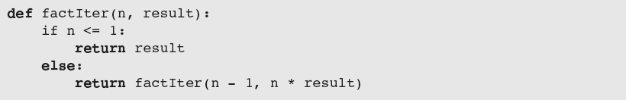
Tail Recursion (continued)
Example:
  Factorial function presented earlier is not tail-recursive
  You can convert this version of the factorial function to a tail-recursive version by performing the multiplication before the recursive call:
Fundamentals of Python: From First Programs Through Data Structures

Slide 58
Summary
n log n sort algorithms use recursive, divide-and-conquer strategy to break the n² barrier
  Examples: Quicksort and merge sort
List can have recursive definition: It is either empty or consists of a data item and another list
  Recursive structure of such lists supports wide array of recursive list-processing functions
Backtracking algorithm can be implemented recursively by running algorithm again on neighbor of the previous state when the current state does not produce a solution
Fundamentals of Python: From First Programs Through Data Structures

Slide 59
Summary (continued)
Recursive descent parsing is a technique of analyzing expressions in a language whose grammar has a recursive structure
Programmer must balance the ease of writing recursive routines against their run-time performance cost
Tail-recursion is a special case of recursion that in principle requires no extra run-time cost
  To make this savings real, the compiler must translate tail-recursive code to iterative code
Fundamentals of Python: From First Programs Through Data Structures

